Slide 1

SSF FI IT system Landscape Version 05.2018

Slide 2
IT System landscape – Current situation
SSF FI @ Bosch
Inside
Launchpad
DCZ
QCZ
PCZ
SAP Fiori
DXG
QXG
PXG
RDX
TDX
DDX
QDX
PDX
SSF FI
YDX
Sandbox
ERP
MDM
Others
ERP
MDM
Others
Test systems
Productive systems
2
CI/DAV1.7 | 08/03/2018
© Robert Bosch GmbH 2018. All rights reserved, also regarding any disposal, exploitation, reproduction, editing, distribution, as well as in the event of applications for industrial property rights.

Slide 3
IT System landscape – Proposal
SSF FI @ Bosch
Inside
Launchpad
DCZ
QCZ
PCZ
SAP Fiori
DXG
QXG
PXG
Connection PXG
1 line for all activities (SPRINT, Rollout Bug fixing,.
RDX
1
TDX
2
QDX
3
PDX
SSF FI
Training, + validation Transports
system copy refresh on demand
Sandbox
YDX
DDX
DDX used for specific projects (POEOnly, Archiving.. ) system open for dev + Testing
Transport line
3
CI/DAV1.7 | 08/03/2018
© Robert Bosch GmbH 2018. All rights reserved, also regarding any disposal, exploitation, reproduction, editing, distribution, as well as in the event of applications for industrial property rights.

Slide 4
IT system landscape
SSF FI @ Bosch
Changes
SSF Fi development , rollouts and bug fixing are covered towards line RDX >>TDX>> PDX.
System QDX, is used :
For ensuring right and smooth transports before going to PDX during DDday.
Training system for CF ( will replace EDX like proposed)
System DDX, is disconnected of the line of development and is used after system copy from TDX for specific project (Archiving or POEOnly…)
Advantages:
Optimisation of IT architecture and services to CF (no need for a new server) ➔ cost saving.
The SSF FI architecture is similar to PXG line ➔ more efficiency in development and support.
Training system is maintained on same level than PDX (DDay transport) ➔ less effort for CF.
CI maintain a double check on released transports with QDX ➔ reliability on released transports.
DDX is used for specific projects, system open for developments and testing phase. ➔ specific projects clearly isolated, less impacts with other activities
4
CI/BMF1 | 08/03/2018
© Robert Bosch GmbH 2018. All rights reserved, also regarding any disposal, exploitation, reproduction, editing, distribution, as well as in the event of applications for industrial property rights.

Slide 5
Backup
5
CI/BMF1 | 08/03/2018
© Robert Bosch GmbH 2018. All rights reserved, also regarding any disposal, exploitation, reproduction, editing, distribution, as well as in the event of applications for industrial property rights.

Slide 6
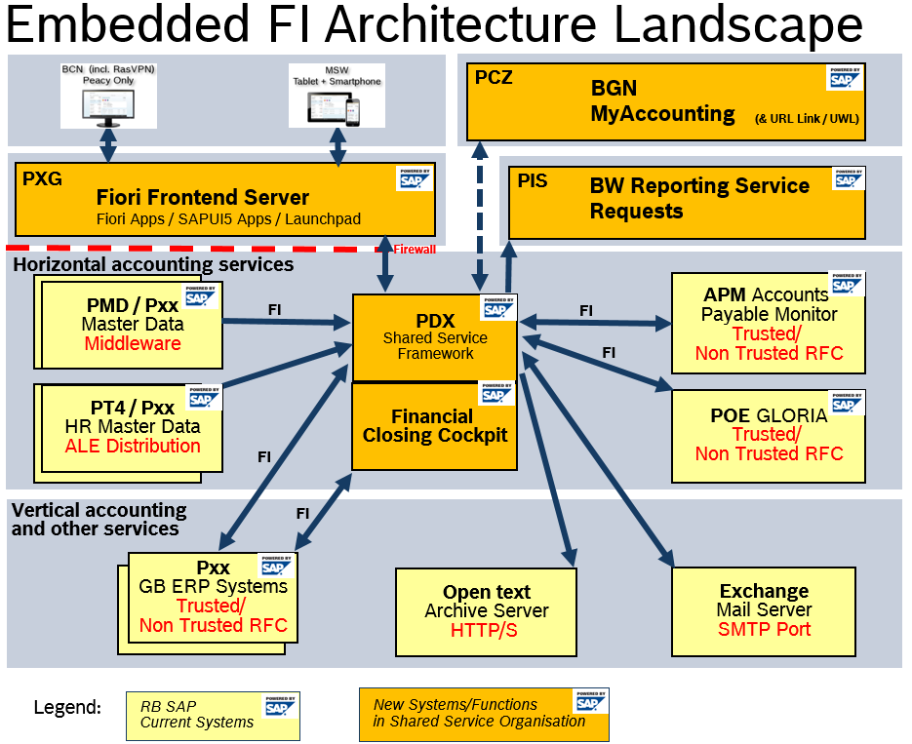
Embedded FI architecture landscape
SSF FI @ Bosch
6
CI/DAV1.3 | 08/03/2018
© Robert Bosch GmbH 2018. All rights reserved, also regarding any disposal, exploitation, reproduction, editing, distribution, as well as in the event of applications for industrial property rights.

Slide 7
IT System landscape – with Training system (Scenario 1)
SSF FI @ Bosch
Inside
Launchpad
DCZ
QCZ
PCZ
xCZ ?
SAP Fiori
DXG
QXG
PXG
xXG ?
Technically possible
RDX
TDX
DDX
QDX
PDX
EDX
SSF FI
??
YDX
Sandbox
ERP
MDM
Others
ERP
MDM
Others
ERP
MDM
Others
Test systems
Productive systems
7
CI/BMF1 | 08/03/2018
© Robert Bosch GmbH 2018. All rights reserved, also regarding any disposal, exploitation, reproduction, editing, distribution, as well as in the event of applications for industrial property rights.

Slide 8
IT System landscape – Proposal (1)
SSF FI @ Bosch
Inside
Launchpad
DCZ
QCZ
PCZ
SAP Fiori
DXG
QXG
PXG
RDX
1
TDX
4
PDX
Line used for development, rollout, bug fixing
SSF FI
2
YDX
DDX
3
QDX
Line used for specific projects (POEOnly, Archiving..)
Sandbox
Sequences of transports QDX is used for validation transports before releasing transports to PDX
8
CI/DAV1.7 | 08/03/2018
© Robert Bosch GmbH 2018. All rights reserved, also regarding any disposal, exploitation, reproduction, editing, distribution, as well as in the event of applications for industrial property rights.

